Slide 1
Task - 2
Internshipstudio - Ethical Hacking

Slide 2
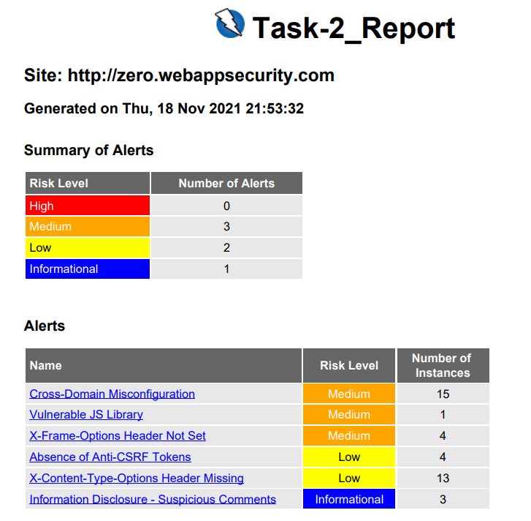

Slide 3
